Slide 1

Capstone – II
ASHRAE- Energy Prediction

Slide 2

Project Objective
The main goal of this project is to apply machine learning to predict the energy usage of a building based on electricity, hot water, chilled water and steam meters.
We’ll be using the dataset provided by ASHRAE as part of their initiative to advance the arts and sciences of HVAC and related fields.
The dataset includes information about energy usage of 1000 buildings over the last 3 years.

Slide 3

Assessing the value of energy efficiency improvements can be challenging as there’s no way to truly know how much energy a building would have used without the improvements.
To know how much energy a building will consume so that improvements can be made is challenging.
In this project we are trying to tackle this problem based on the data available for different sites
We predict the energy consumption for next year years.
Problem Statement

Slide 4
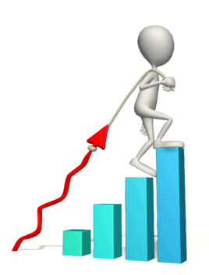
Our Approach
Milestone A
Data Gathering
Milestone B
Exploratory Data Analysis
Milestone C
Data Pre-processing and Prototyping
Milestone E
Final Product
Milestone D
Training Mode / Making Predictions

Slide 5

DATA
6 different files with 17 unique features
There are 16 unique site ids, hosting 1448 unique buildings.
The buildings primary use range among 16 unique categories (i.e. Office, Education, etc.).
In addition, there are 4 unique meters to measure the energy use (chilled water, electric, hot water , steam ).
Furthermore, since the time range is between 2015 and 2018, there are over 61 million unique time stamps! This is a lot of data. In fact, the size of those files for training and testing were ~0.7 and 1.4 GBs respectively,

Slide 6
FEATURES
SiteID
Building_ID
Primary Use
Square Feet
Year Built
Floor Count
Time Stamp
Air Temperature
Cloud Coverage
Dew Temperature
Precipitation Depth
Pressure for Sea Level
Wind Direction
Wind Speed
Row Id
Meter Reading

Slide 7
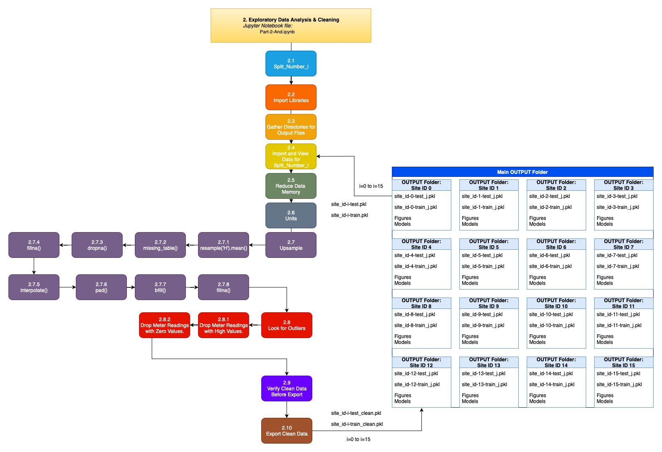
Data Exploratory and Cleaning
We chose to Up sample the data to hourly since that was the frequency at which it came in raw form most.
Missing data for the once reduced was handled as below:
dropping values for more than 40% data missing
filling null values,
interpolating,
forward filling,
backward filling

Slide 8
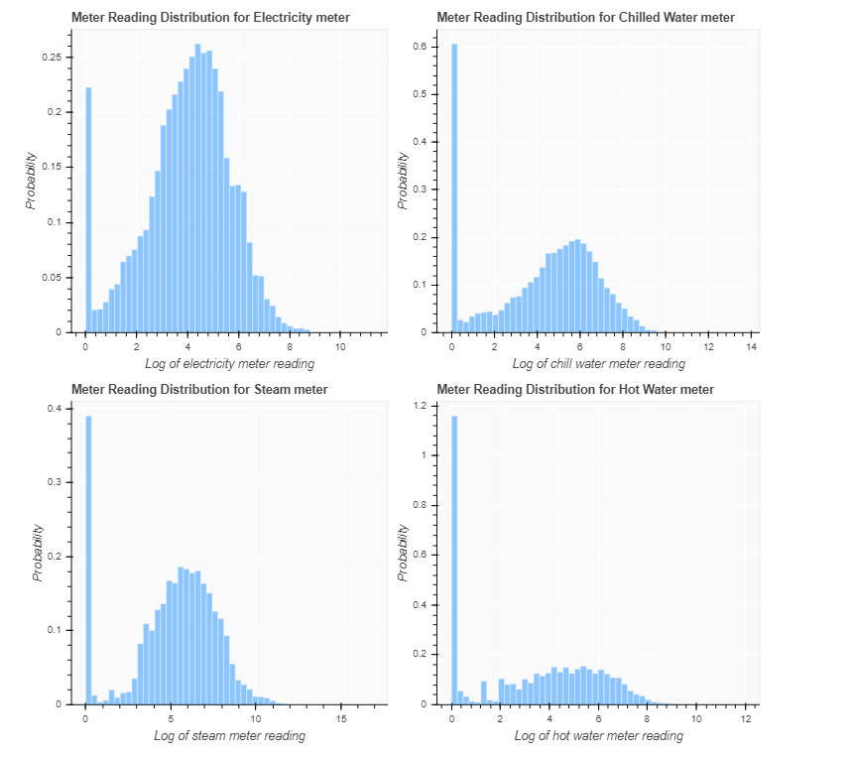
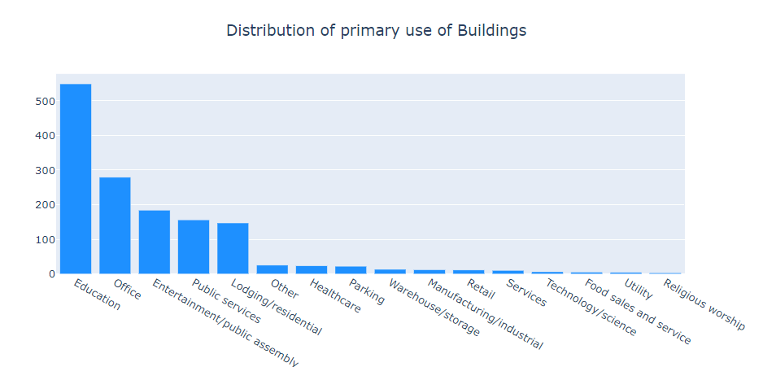
Exploratory Data Analysis- Contd

Slide 9
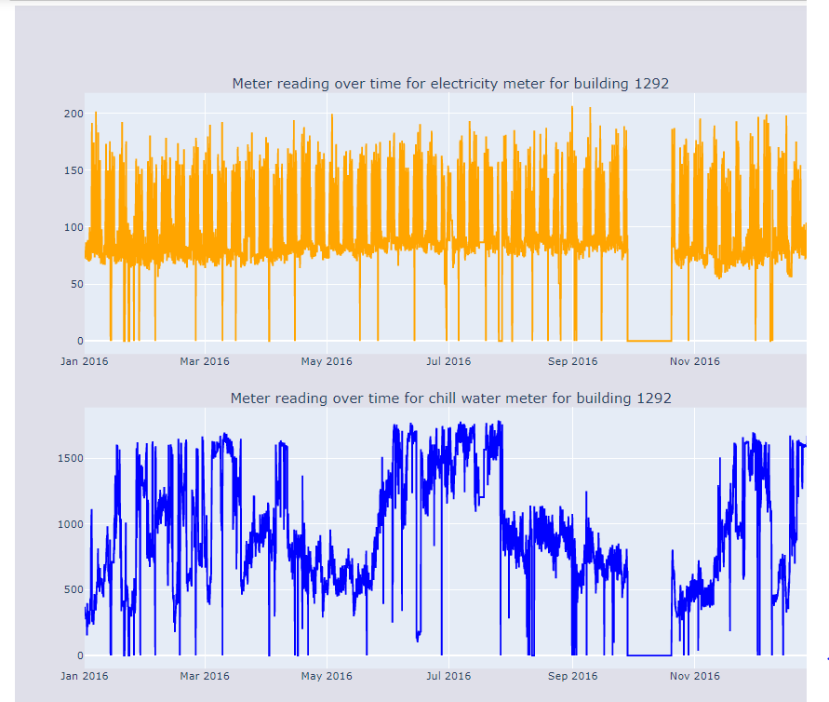
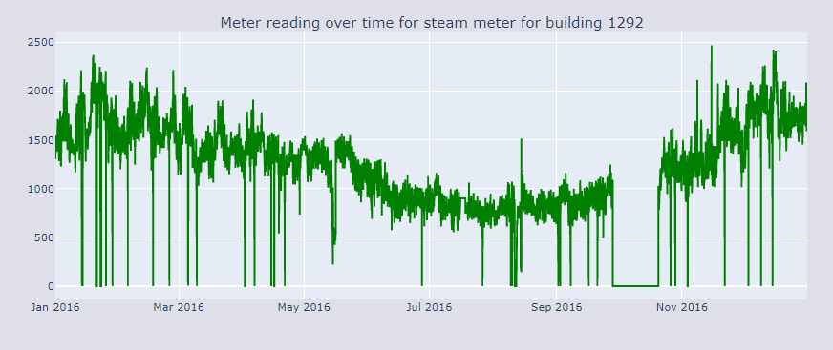
Exploratory Data Analysis-Continued

Slide 10

Data Pre-Processing
Train and Test Split:
We have split the data so that a portion was captured for each season for training and validation sets.
We will be using the below month’s data as testing.
Winter -January (1),
Spring - April (4),
Summer - July (7)
Fall - October (10)
Scaling the Data:
We used the MinMaxScaler to get values between 0 and 1.

Slide 11

Machine Learning Algorithm
Linear Regression
Light Gradient Boosting
Keras Neural Network

Slide 12

Light GBM
Linear Regression
Keras Neural Network
Tree Learning Algorithm
LGBM can handle large sizes of data with ease and can process it extremely fast.
it focuses on maximizing the accuracy of its results.
Faster training speed and higher efficiency
Feature importance’s may not be robust to variation in the training dataset
Capable of running on top of either TensorFlow or Theano
High running speed
Runs seamlessly on CPU and GPU
Lack of pre-trained models
Errors thrown are difficult to debug.
It is the supervised learning algorithm. It works well on the linear models.
Can be regularized to avoid overfitting and this is intuitive
May not work well when the hypothesis function is non-linear.
Very sensitive to outliers

Slide 13
Model Evaluation
Of all the models used we chose to go ahead with LightGBM regressor.
We split the data into K-fold of 3 for training/validation. Then predicted using the test set
The accuracy of these models is evaluated based on the Root Mean Squared Logarithmic Error (RMSLE):
Root Mean Squared Logarithmic Error (RMSLE) of 1.566 public and our final run was a 1.292 public score (~20% better).

Slide 14

Our Progress
Exploratory Data Analysis
Data Pre-processing
Model Training
Final Product
Milestone
Once the client is registered for subscription, dashboard will be sent to client via Email with their meter statistics.
We will be using Dash which is python framework for building our analytical web application.
Final Product
Providing Recommendations based on the meter readings about the electronic equipment's used.
Analysing area energy consumption for setting up industries and residential complex
Future Scope
Project Current Status

Slide 15
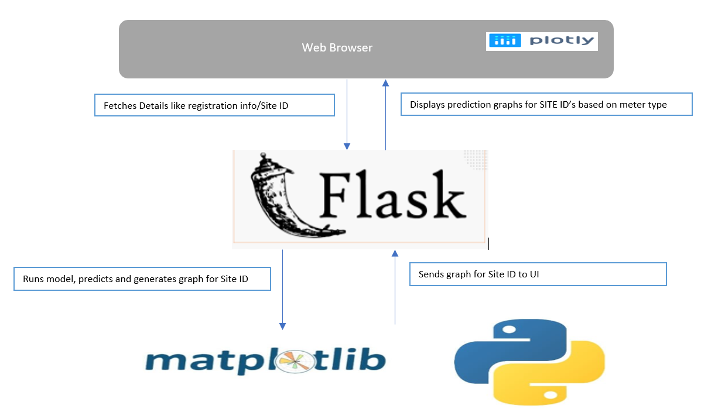
Architecture
Dash is a python framework for building web applications. Written on top of Flask, Plotly.js and React.js, Dash is well-suited for quickly building customized web applications. Once built, the web application can easily be deployed on a cloud platform such as Heroku.

Slide 16
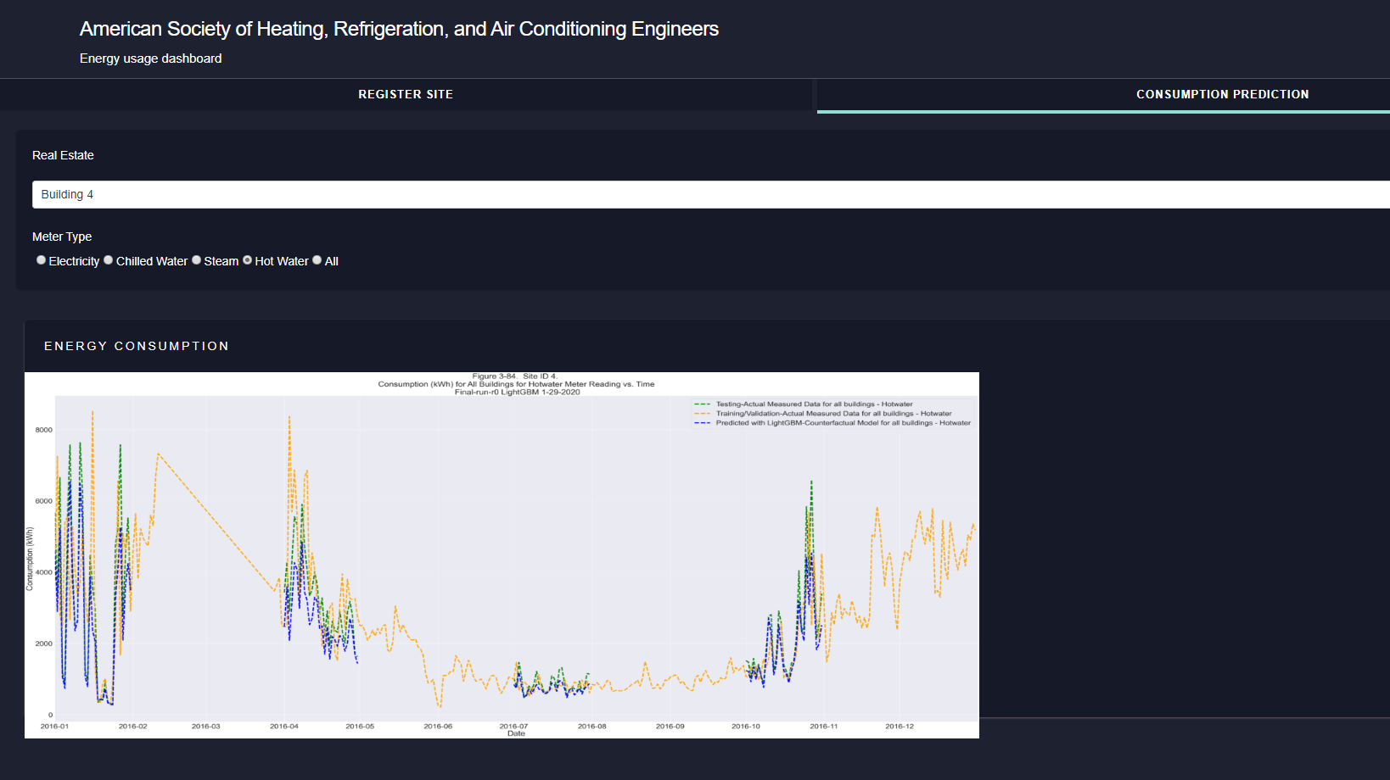
Dashboard

Slide 17

PROJECT TEAM
Ahnch Bala
Sonakshi Karkera
Surbhi Thakur
Arun Kalaeswaran

Slide 18

THANK YOU

